Slide 1

OOP
Object Oriented Programming
Lecture 19
Lecture 1

Slide 2
Vectors and Pair in C++
(Dynamic Array)

Slide 3
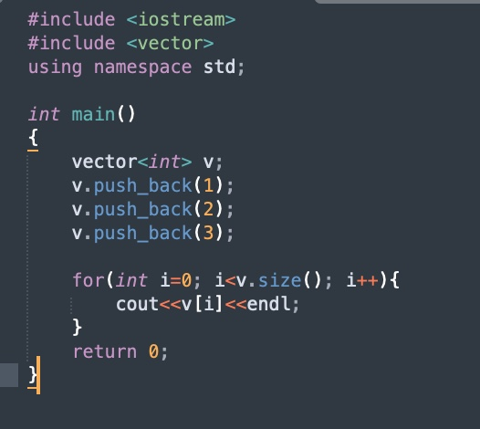
Push Values Using Vector

Slide 4
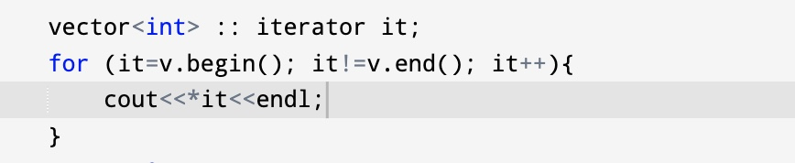
Using Iterator

Slide 5
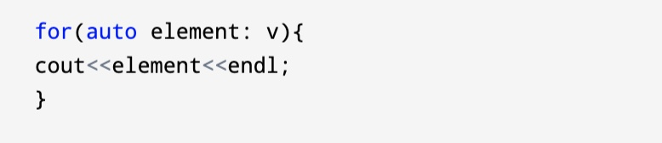
Using auto

Slide 6
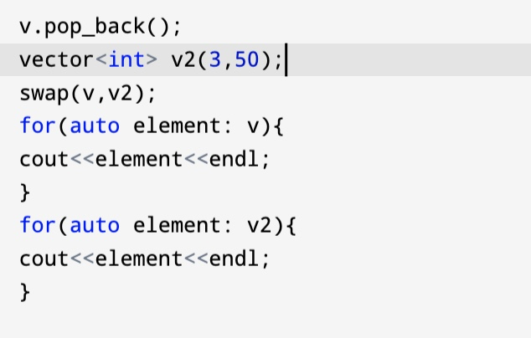
Swap Function

Slide 7


Slide 8
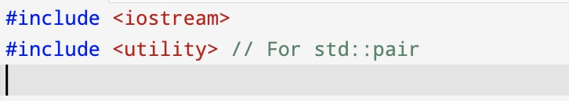
In C++, a pair is a container from the Standard Template Library (STL) that allows you to store two values of potentially different types together. The std::pair class is part of the <utility> header.
Basic Features:
It holds two data members: first and second.
You can use pairs to return multiple values from functions or combine related data.

Slide 9
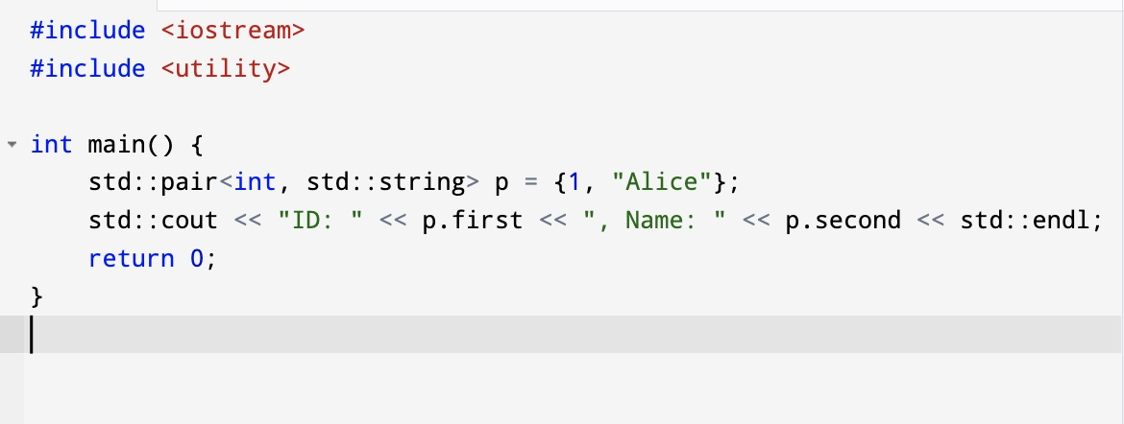
Example 1:

Slide 10
Example 2:
Explain the use of std::pair in C++ with an example. Create two pairs: one initialized directly and the other using std::make_pair. Demonstrate how to access pair elements and assign one pair to another. Provide the output of your program.

Slide 11
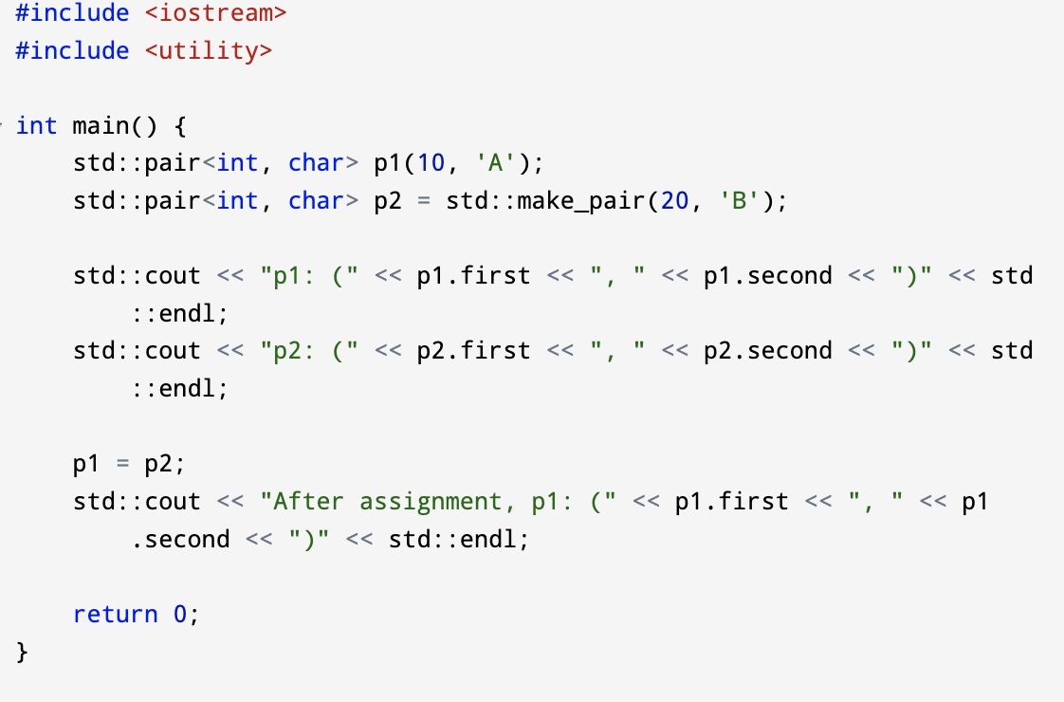
Creating and Assigning Pairs

Slide 12
Using Pairs in Containers Pairs are often used in STL containers like vectors or maps.
Create a C++ program to store and display a list of students using vector of pair. Each student has an ID (integer) and a Name (string). The program should display the ID and Name of all students in the format:
ID: <value>, Name: <value>
ID: 1, Name: Alice
ID: 2, Name: Bob

Slide 13
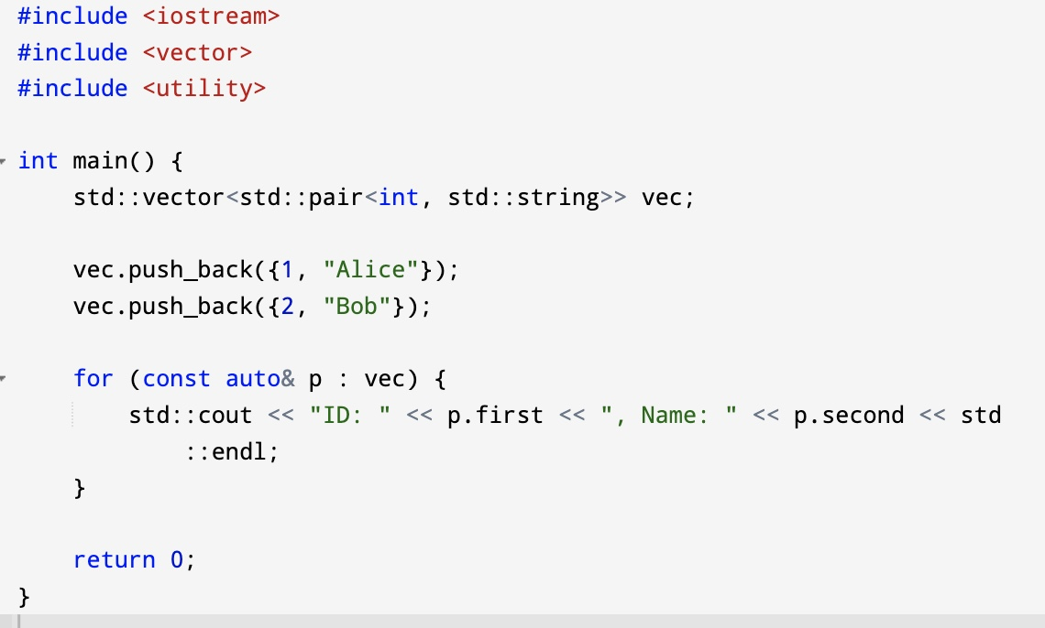
Using Pairs in Containers Pairs are often used in STL containers like vectors or maps.

Slide 14
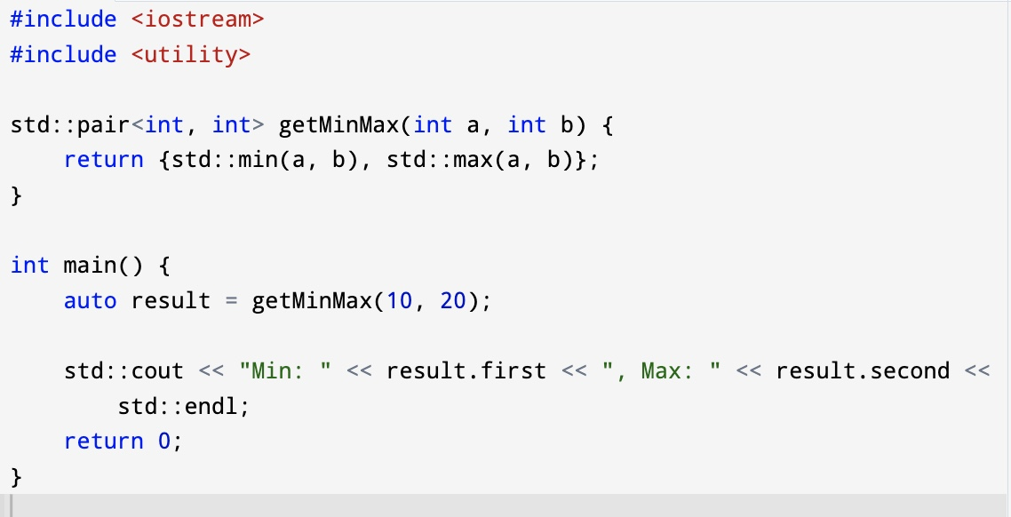
Returning Multiple Values from a Function

Slide 15
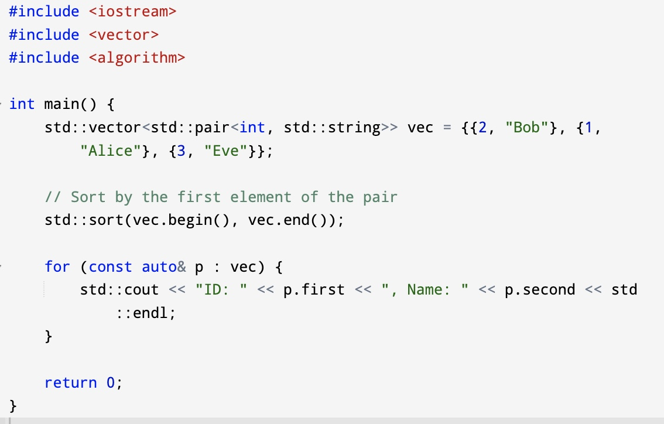
Sorting a Vector of Pairs

Slide 16
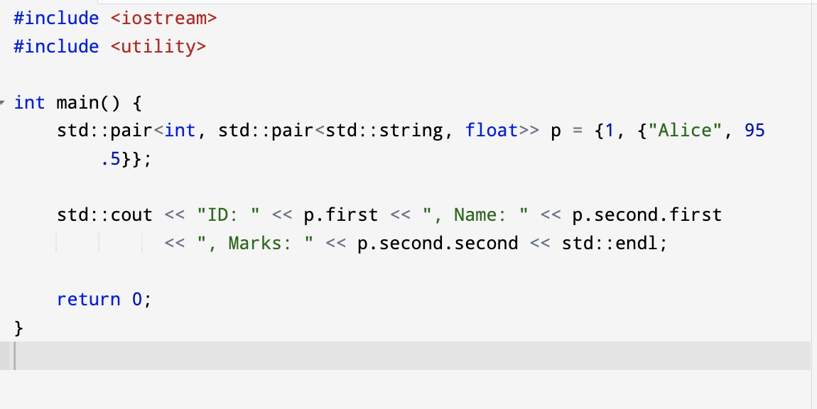
Nested Pairs

Slide 17
Example
Using vectors in an Object-Oriented Programming (OOP) program involves integrating std::vector (a dynamic array from the Standard Template Library) with classes. Below is an example that demonstrates vectors in an OOP context.
Example: Student Management System
In this program:
A Student class holds details of a single student.
A StudentManager class manages a list of students using a vector.

Slide 18
End of Lecture

